Slide 1
PURIFICATION OF WATER USING NANOTECHNOLOGY

Slide 2
TEAM NAME-NANOENGINEERS SAKIB KHAN PATHAN DIMPLE NAINANI BHARAT MEGHWAL SHUBHAM JOSHI

Slide 3
INTRODUCTION
The adaptation of highly advanced nanotechnology to traditional process engineering offers new opportunities for development of advanced water and wastewater technology processes. Here, an overview of recent advances in nanotechnologies for water and wastewater processes is provided, including nanobased materials, processes, and their applications. Besides the promising technological enhancements, the limitations of nanotechnology for water applications, such as laws and regulations as well as potential health risks, are reported.

Slide 4
State of science and technology: nanobased materials, processes, and applications
Nanomaterials have unique size-dependent properties related to their high specific surface area (fast dissolution, high reactivity, strong sorption) and discontinuous properties (such as superparamagnetism, localized surface plasmon resonance, and quantum confinement effect). These specific nanobased characteristics allow the development of novel high-tech materials for more efficient water and wastewater treatment processes, namely membranes, adsorption materials, nanocatalysts, functionalized surfaces, coatings, and reagents.

Slide 5
Overview of types of nanomaterials applied for water and wastewater technologies
Nanomaterial | PROPERTIES | Applications
Nanoadsorbents | + high specific surface, higher adsorption rates, small footprint. − high production costs. | Point-of-use, removal of organics, heavy metals, bacteria
Nanometals and nanometal oxides | + short intraparticle diffusion distance compressible, abrasion-resistant, magnetic + photocatalytic (WO₃, TiO₂) − less reusable | Removal of heavy metals (arsenic) and radionuclides, media filters, slurry reactors, powders, pellets
Membranes and membrane processes | + reliable, largely automated process − relative high energy demand | All fields of water and waste­water treatment processes

Slide 6
Adsorption
Adsorption is the capability of all solid substances to attract to their surfaces molecules of gases or solutions with which they are in close contact. Solids that are used to adsorb gases or dissolved substances are called adsorbents, and the adsorbed molecules are usually referred to collectively as the adsorbate. Due to their high specific surface area, nanoadsorbents show a considerably higher rate of adsorption for organic compounds compared with granular or powdered activated carbon. They have great potential for novel, more efficient, and faster decontamination processes aimed at removal of organic and inorganic pollutants like heavy metals and micropollutants. In addition to saving of adsorbent materials, the superior process efficacy enables implementation of more compact water and wastewater treatment devices with smaller footprints, particularly for decentralized applications and point-of-use systems. Current research activities mainly focus on the following types of nanoadsorbents:
carbon-based nanoadsorbents ie, carbon nanotubes (CNTs)
metal-based nanoadsorbents
polymeric nanoadsorbents
zeolites

Slide 7
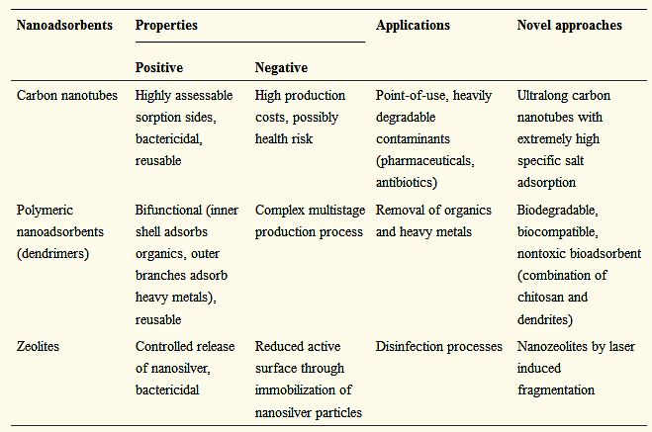
Properties, applications, and innovative approaches of nanoadsorbents

Slide 8
Nanometals and nanometal oxides
Nanoscale metal oxides are promising alternatives to activated carbon and effective adsorbents to remove heavy metals and radionuclides. As well as having a high specific surface area, they feature a short intraparticle diffusion distance and are compressible without a significant reduction of surface area. Some of these nanoscale metal oxides (eg, nanomaghemite and nanomagnetite) are superparamagnetic, which facilitates separation and recovery by a low-gradient magnetic field. They can be employed for adsorptive media filters and slurry reactors. Nano iron hydroxide [α-FeO(OH)] is a robust abrasion-resistant adsorbent with a huge specific surface area that enables adsorption of arsenic from waste and drinking water.ArsenXnp (SolmeteX Inc., Philadelphia, PA, USA) is a commercially available hybrid ion exchange medium comprising iron oxide nanoparticles and polymers and is highly efficient in removing arsenic and requires little back wash. Usually, nanometals and nanometal oxides are compressed into porous pellets or used in powders for industrial use.

Slide 9
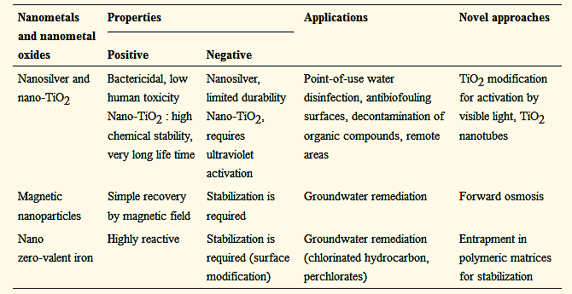
Properties, applications, and innovative approaches for nanometals and nanometal oxides

Slide 10
Photocatalysis
Photocatalysis is an advanced oxidation process that is employed in the field of water and wastewater treatment, in particular for oxidative elimination of micropollutants and microbial pathogens. As reported in the literature, most organic pollutants can be degraded by heterogeneous photocatalysis. Due to its high availability, low toxicity, cost efficiency, and well known material properties, TiO₂ is widely utilized as a photocatalyst. When TiO₂ is irradiated by ultraviolet light with an appropriate wavelength in the range of 200–400 nm, electrons will be photoexcited and move into the conduction band. As a result of photonic excitation, electron-hole pairs are created, leading to a complex chain of oxidative-reductive reactions. Hence, the biodegradability of heavily decomposable substances can be increased in a pretreatment step. Principally, persistent compounds like antibiotics or other micropollutants can be photocatalytically eliminated in polishing processes, such as tertiary clarification steps in municipal wastewater treatment plants. However, as the ultraviolet A radiation is only about 5% that of sunlight, the photon efficiency is quite low, limiting use on an industrial scale.

Slide 11
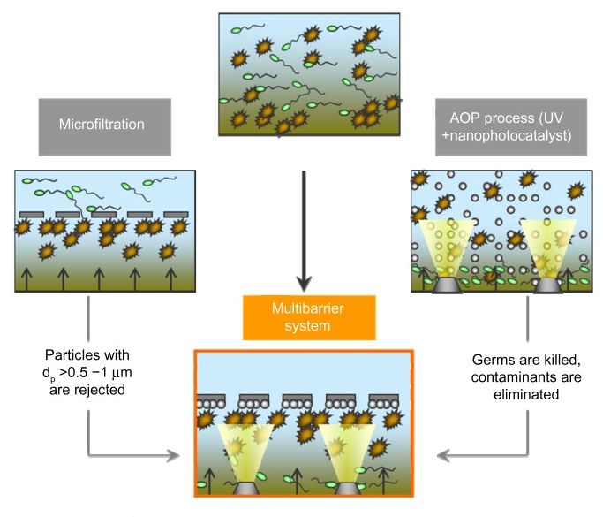

Slide 12
Limitations of nanobased materials and processes for water applications
Commercialization of nanoengineered materials for water and wastewater technology strongly depends on their impact on the aqueous environment. Numerous studies including toxicity tests, life cycle analysis, technology assessment, and pathways and dispersal of nanoparticles in water bodies have been carried out in order to evaluate the health risks of nanomaterials (see section on Potential ecotoxicity risks of nanobased materials and processes related to water applications). The results of these studies have led to a better understanding of the behavior of nanoparticles such as CNTs, TiO₂, and silver nanoparticles in aqueous systems; thus, stakeholders from administration, politics, and industry are supported to create new laws and regulations or modify present ones. However, many studies have yielded contradictory results, since no general standards and conditions for experimental tests and measurements have been determined, which slows down the necessary decision processes.

Slide 13
Legal background of nanobased materials and processes related to water applications
The enabling nanotechnology is promoted as one of the most challenging key technologies of this century. Billions of dollars have been spent on research framework programs intended to promote nanotechnology and to bring novel materials and processes to market. For example, the 2015 federal budget has allocated more than 1.5 billion US dollars to the National Nanotechnology Initiative (Arlington, VA, USA), that has nanotechnology-related activities ongoing in 20 departments and independent agencies. Horizon 2020, the research framework program in the European Union, provides US$110 billion over a period of 7 years for research and innovation projects, including US$92 million for water innovations and US$686 million for nanotechnology in 2014. In order to combine water and nanotechnology, there are joint calls for “low-energy solutions for drinking water production” that involve implementation of novel nanoengineered materials and processes for water applications.

Slide 14
Potential ecotoxicity of nanobased materials and processes related to water applications
Nanomaterials in water do not directly affect humans, but there is the possibility of uptake of nanomaterials via consumption of fish, so the impact of nanomaterials on aquatic organisms needs to be taken into consideration. The harmful effects of nanomaterials on aquatic organisms are related mainly to nanoparticles, so the following section is concerned with the potential toxicity of TiO₂ nanoparticles, silver nanoparticles, and CNTs, which are the most common nanoparticle species.

Slide 15
Harmful effects on aquatic organisms
An extensive overview of the miscellaneous effects of TiO₂ nanoparticles on various kinds of aquatic organisms is given in a case study published by the US Environmental Protection Agency in 2010.In that study, different types of nano-TiO₂, different pathways of entry, and different effects on the environment and organisms were shown by comparing several studies of the influence of nanoparticles, exemplified by TiO₂, on different kinds of organisms, including bacteria, algae, invertebrates, fish, and plants. Their reported effects on aquatic organisms included decreased reproduction of daphnia as well as respiratory distress, pathological changes in the gills and in testine, and behavioral changes in fish.Various acute effects on algae could be demonstrated depending on the type and concentration of TiO₂; however, the median effective concentration depended mainly on the size of the particles. summarizes the results of several toxicity studies for different types of TiO₂ nanoparticles, nano-ZnO, nano-CuO, and nano-SiO₂, as well as fullerenes and CNTs and their effect on various aquatic organisms.

Slide 16
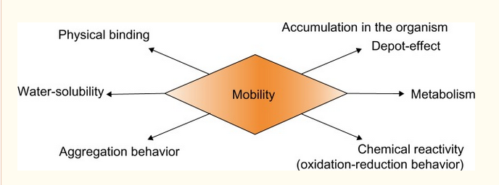
Fate and removal of nanomaterials in water
Emission of nanoparticles into the environment may come from point sources, eg, production facilities, landfills, or wastewater treatment plants, or from nonpoint sources, such as washing machines, clothing, or other materials containing nanoparticles. For example, a certain amount of nanosilver is released from clothes by washing depending on the adhesion of the silver to the clothes and the specific washing conditions. Commercially available nanosocks have been shown to leach 25% of their total silver content within minutes at pH 10.

Slide 17
Conclusion and future prospects
There is a significant need for novel advanced water technologies, in particular to ensure a high quality of drinking water, eliminate micropollutants, and intensify industrial production processes by the use of flexibly adjustable water treatment systems. Nanoengineered materials, such as nanoadsorbents, nanometals, nanomembranes, and photocatalysts, offer the potential for novel water technologies that can be easily adapted to customer-specific applications. Most of them are compatible with existing treatment technologies and can be integrated simply in conventional modules. One of the most important advantages of nanomaterials when compared with conventional water technologies is their ability to integrate various properties, resulting in multifunctional systems such as nanocomposite membranes that enable both particle retention and elimination of contaminants. Further, nanomaterials enable higher process efficiency due to their unique characteristics, such as a high reaction rate.
However, there are still several drawbacks that have to be negotiated. Materials functionalized with nanoparticles incorporated or deposited on their surface have risk potential, since nanoparticles might release and emit to the environment where they can accumulate for long periods of time. Up until now, no online monitoring systems exist that provide reliable real-time measurement data on the quality and quantity of nanoparticles present only in trace amounts in water, thus offering a high innovation potential. In order to minimize the health risk, several national and international regulations and laws are in preparation. Another more technical limitation of nanoengineered water technologies is that they are rarely adaptable to mass processes, and at present, in many cases are not competitive with conventional treatment technologies. Nevertheless, nanoengineered materials offer great potential for water innovations in the coming decades, in particular for decentralized treatment systems, point-of-use devices, and heavily degradable contaminants.

Slide 18
THANKYOU

